Slide 1
8.Pointers(Part II) Dynamic Memory Allocation

Slide 2
Mr. k.v.bhatt
Lecturer, Information Technology,
SBMP

Slide 3
Learning Outcomes
Students will be able to:
Create a pointer to an object.
Create objects dynamically

Slide 4
Pointer to an object

Slide 5
A pointer to an object
An object is a variable of type class.
A pointer to an object must have the same type of the object to whom it points.
Syntax: class_name ob;
class_name *pob=&ob;
Example: Product p1;
Product *pob = &p1;
To access the members of a class i.e. functions, we can use * as below:
(*pob).setProduct();
OR using the arrow operator ->
pob->setProduct();

Slide 6
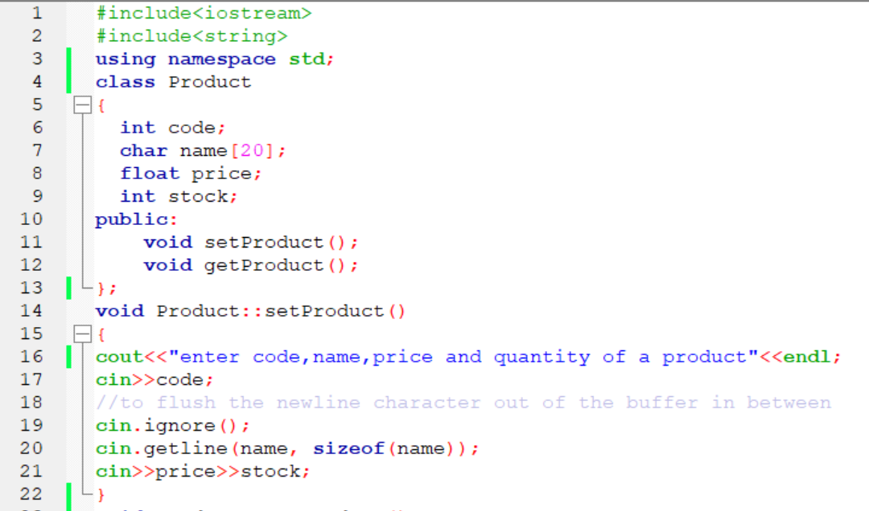
A pointer to an object

Slide 7
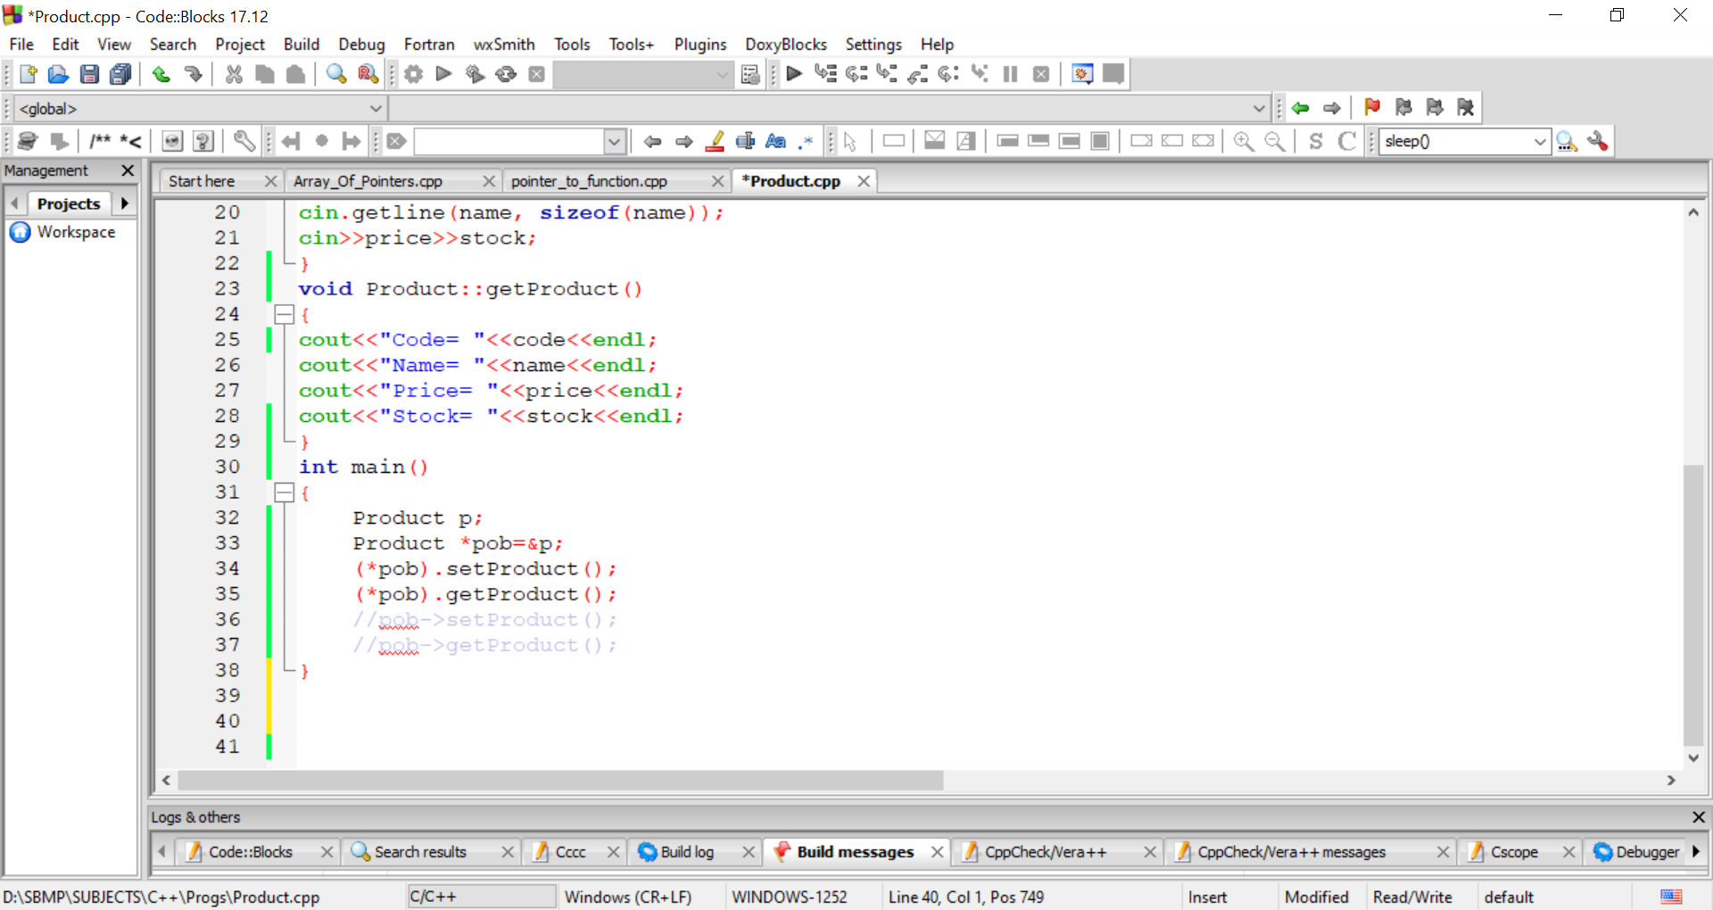
A pointer to an object
Note: precedence of . is higher than * as per right associativity therefore *pob must be written inside the ( )

Slide 8
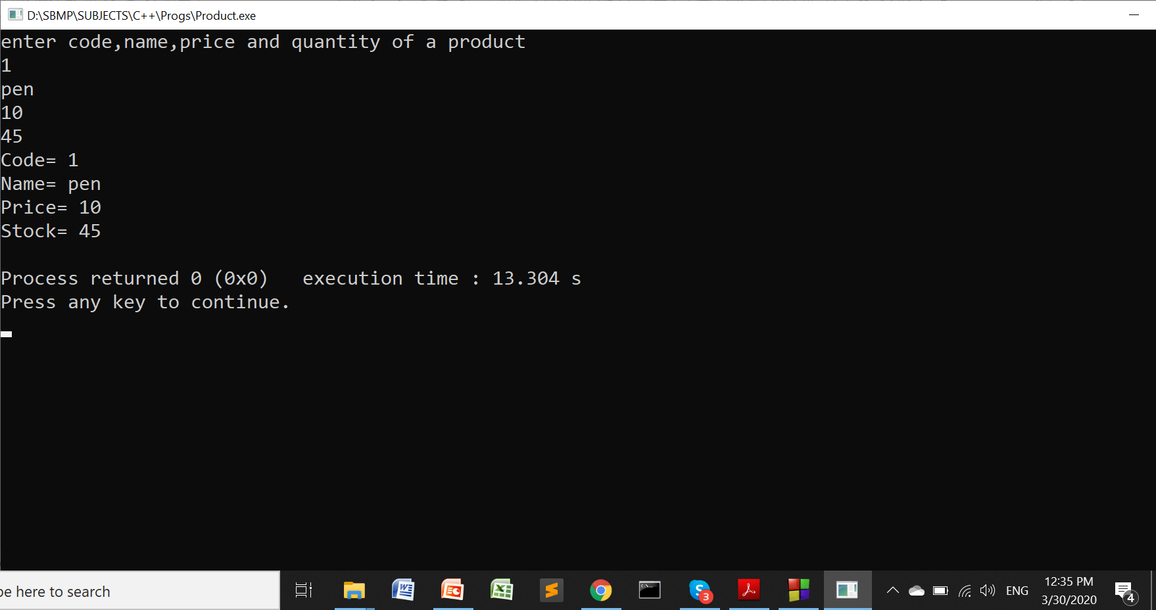
A pointer to an object

Slide 9
Creating an object Dynamically
So far whatever objects we have created are created using static memory allocation.
In C++, to create an object dynamically, we have to use pointer and new operator.
Syntax: class_name *ptr = new class_name();
Example : Product *pob = new Product();
Working of new operator
The new operator allocates memory for the object dynamically (at run time) and returns address of the object to the pointer variable at the left hand side of =.
The members of the class are invoked using -> (arrow operator) or * operator

Slide 10
Creating an object Dynamically
In the above program, we have to write main() as follows:
Product *pob=new Product();
pob->setProduct(); // or * can be used
pob->getProduct();
Note: Objects created dynamically must be deallocated manually using delete operator in C++
Syntax: delete ptr;
Example: delete pob;

Slide 11
Statically created objects are deallocated as their scope ends i.e. Product p1;
The object created dynamically is to be deallocated explicitly by the programmer.

Slide 12
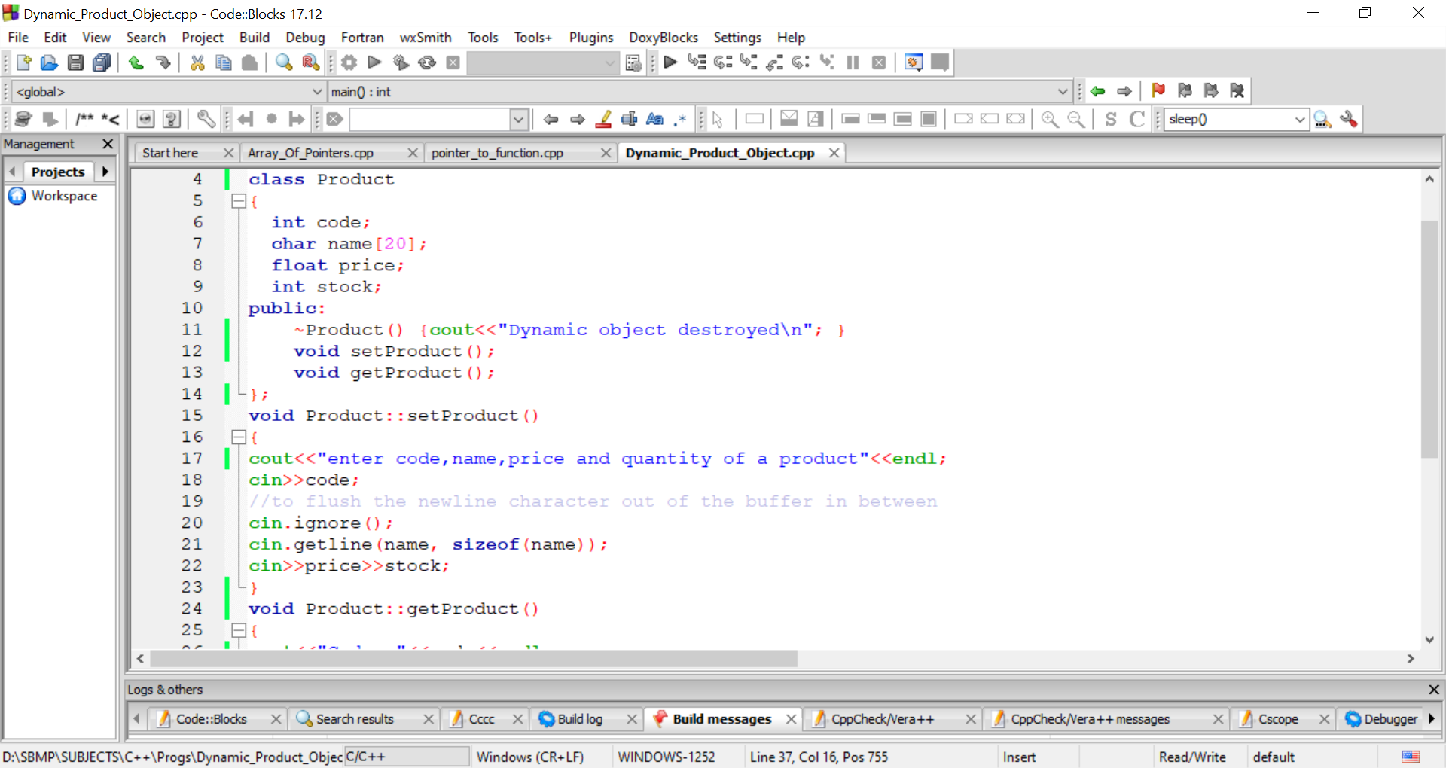
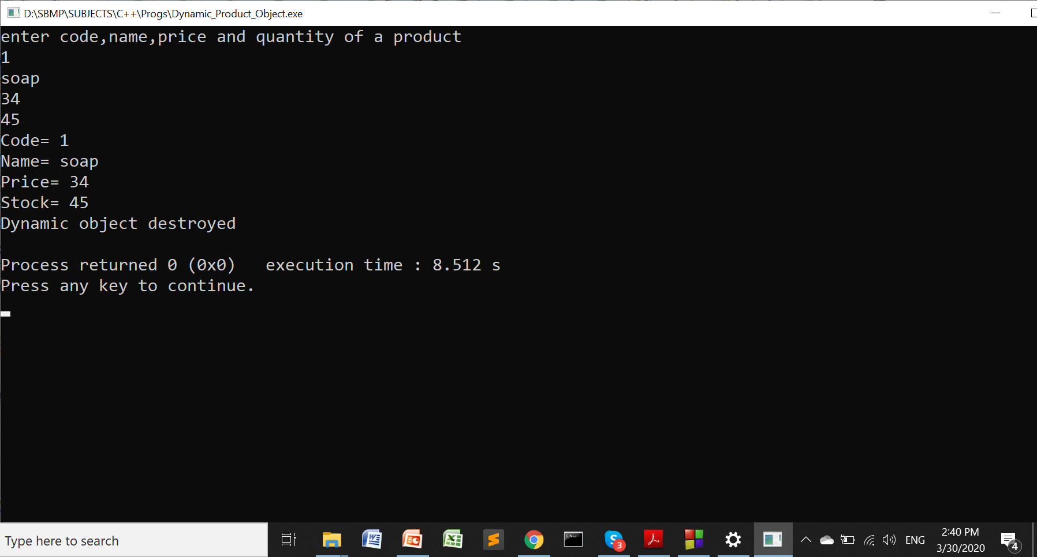
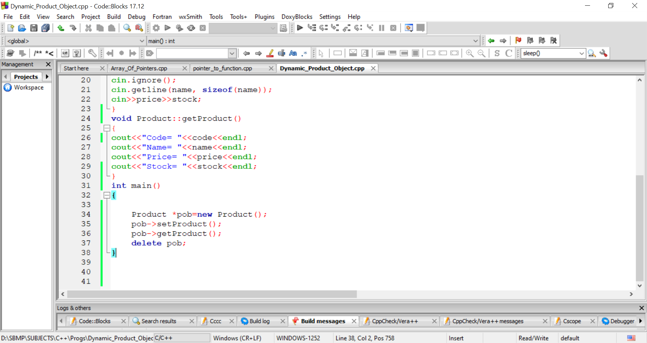
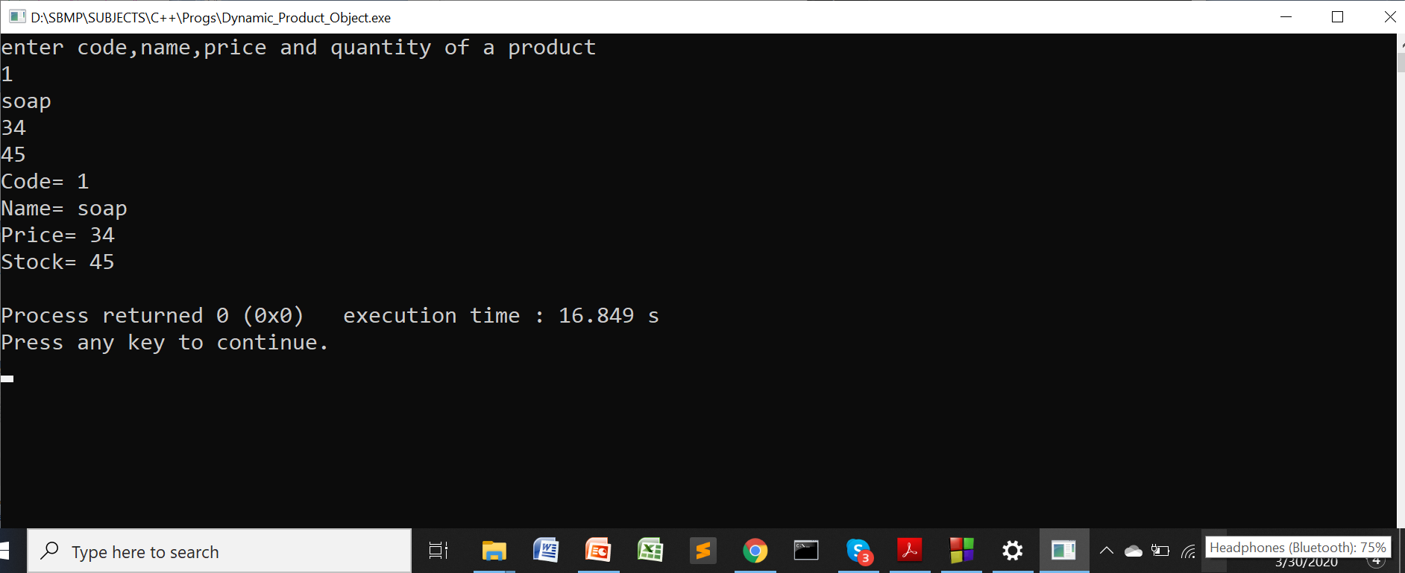
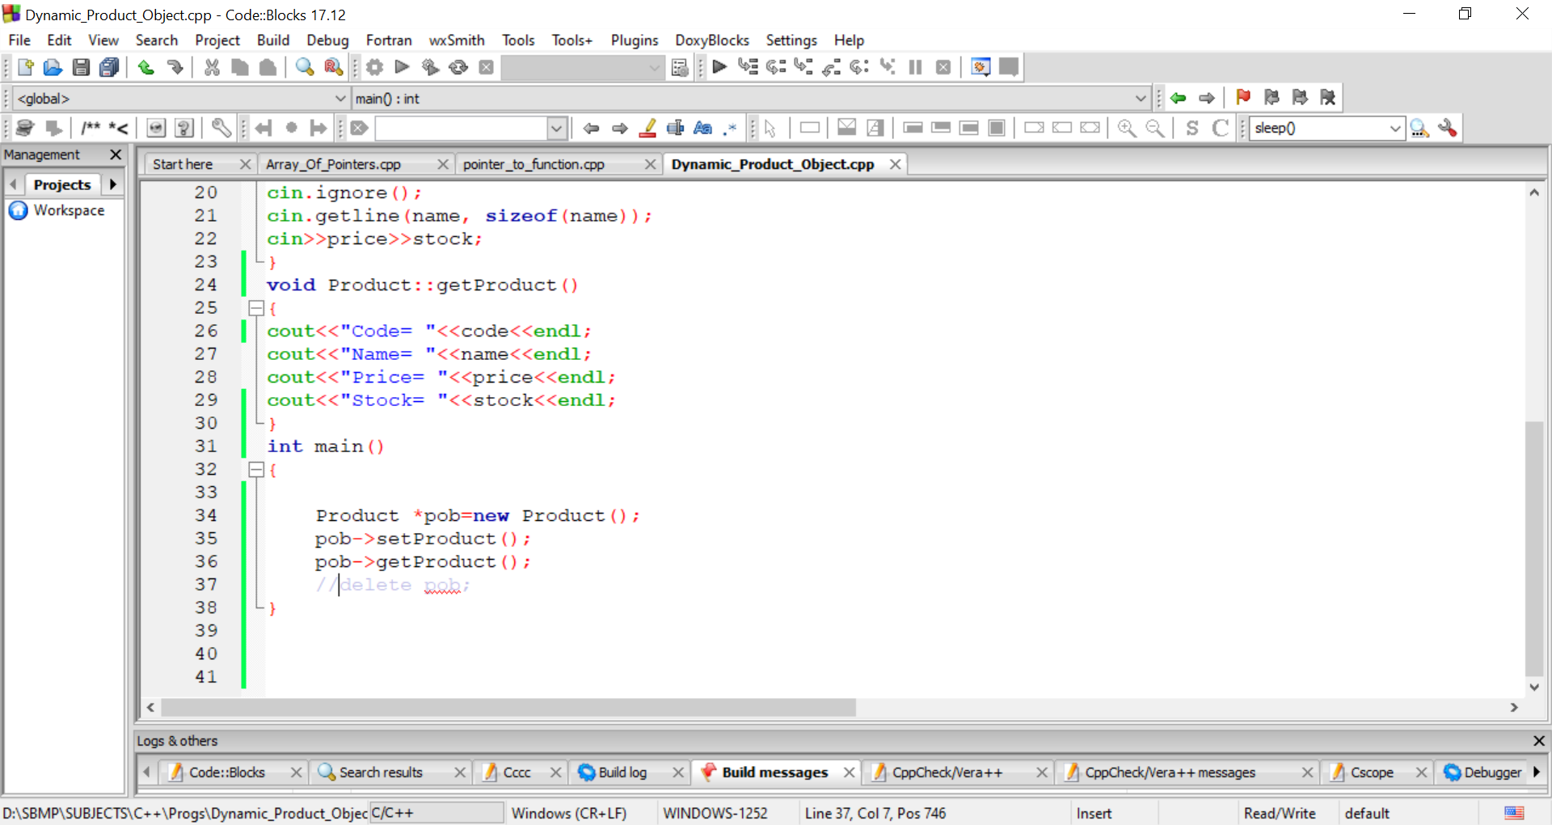

Slide 13
Creating object array Dynamically
We can create an array of objects dynamically using new operator
It overcomes two disadvantages of static memory allocation i.e. Product p[10];
(i) User has no choice to specify the size from the keyboard i.e. a constant 10 is to be written.
(ii) If user uses less than 10 objects then memory space is wasted.
We can overcome these disadvantages using dynamic memory allocation.
int n;
cout<<“How many products you want to enter?\n”;
cin>>n;
Product *p = new Product[n];

Slide 14
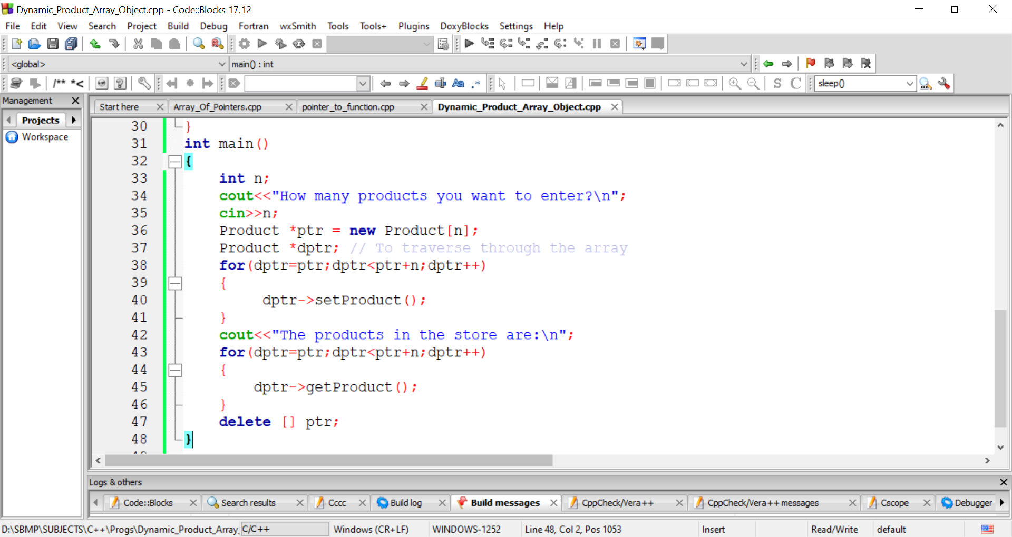
Creating object array Dynamically
ptr
dptr

Slide 15
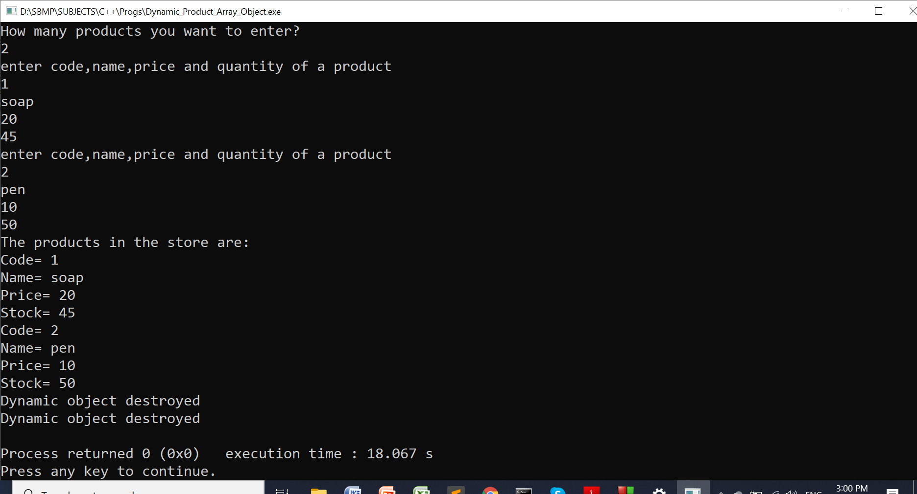
Creating object array Dynamically

Slide 16
this Pointer

Slide 17
this pointer
C++ uses one special pointer named this which stores the address of the object which invokes the member function.
When an object invokes a member function, it’s address is implicitly stored in this pointer.
Example: p1.setProduct(); // The address of p1 is getting stored in this pointer.
this
p1
inside the member function, called by p1

Slide 18
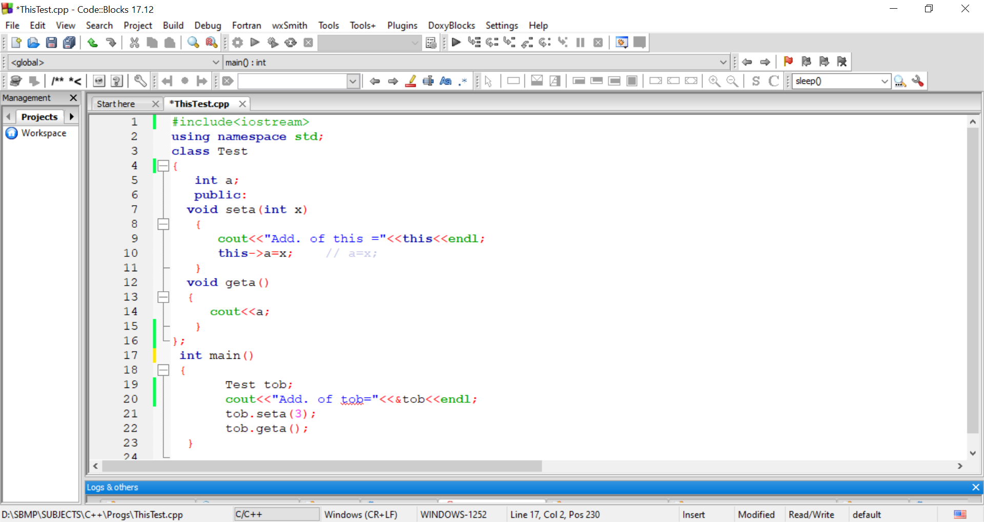
this pointer
Note:
a=x is a short hand notation of
this->a =x;

Slide 19
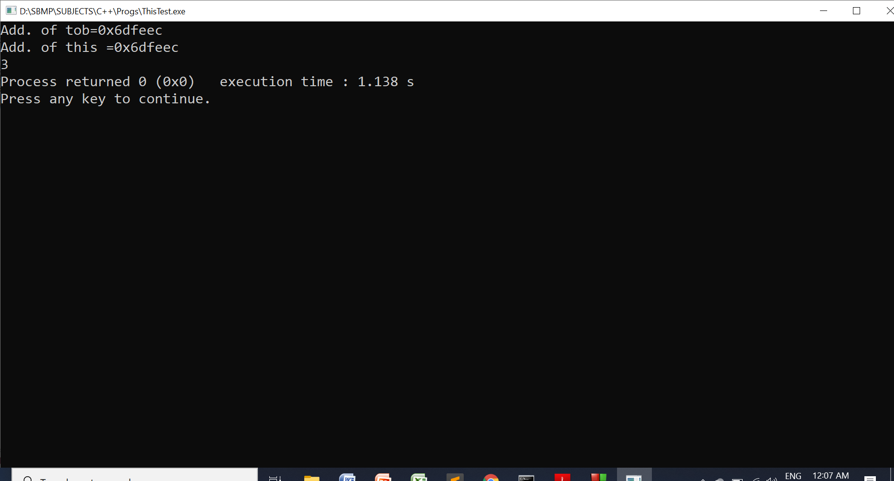
this pointer

Slide 20
Pointers to derived classes

Slide 21
Base class pointer to derived class object
It is possible to store address of derived class object to base class pointer.
Example: Consider B is a base class and D is a derived class
B *bptr; // pointer of type B
B b; // b is an object of type B
D d; // d is an object of type D
bptr = &d; // bptr takes address of d
Note: Using bptr, we can only access the public members of D which are inherited by B. It can not access personal properties (members) of D.

Slide 22
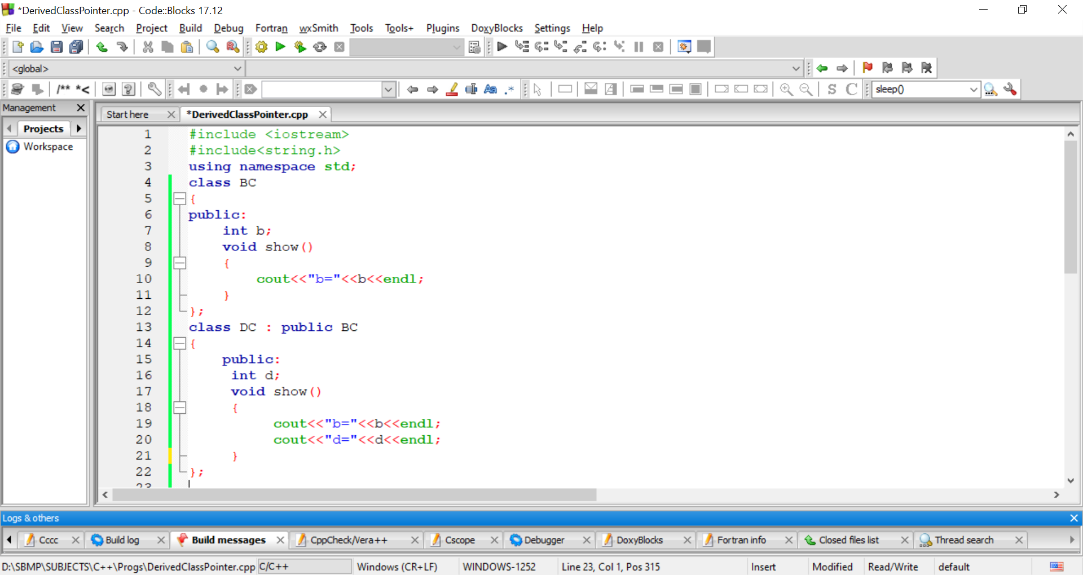
Base class pointer to derived class object

Slide 23
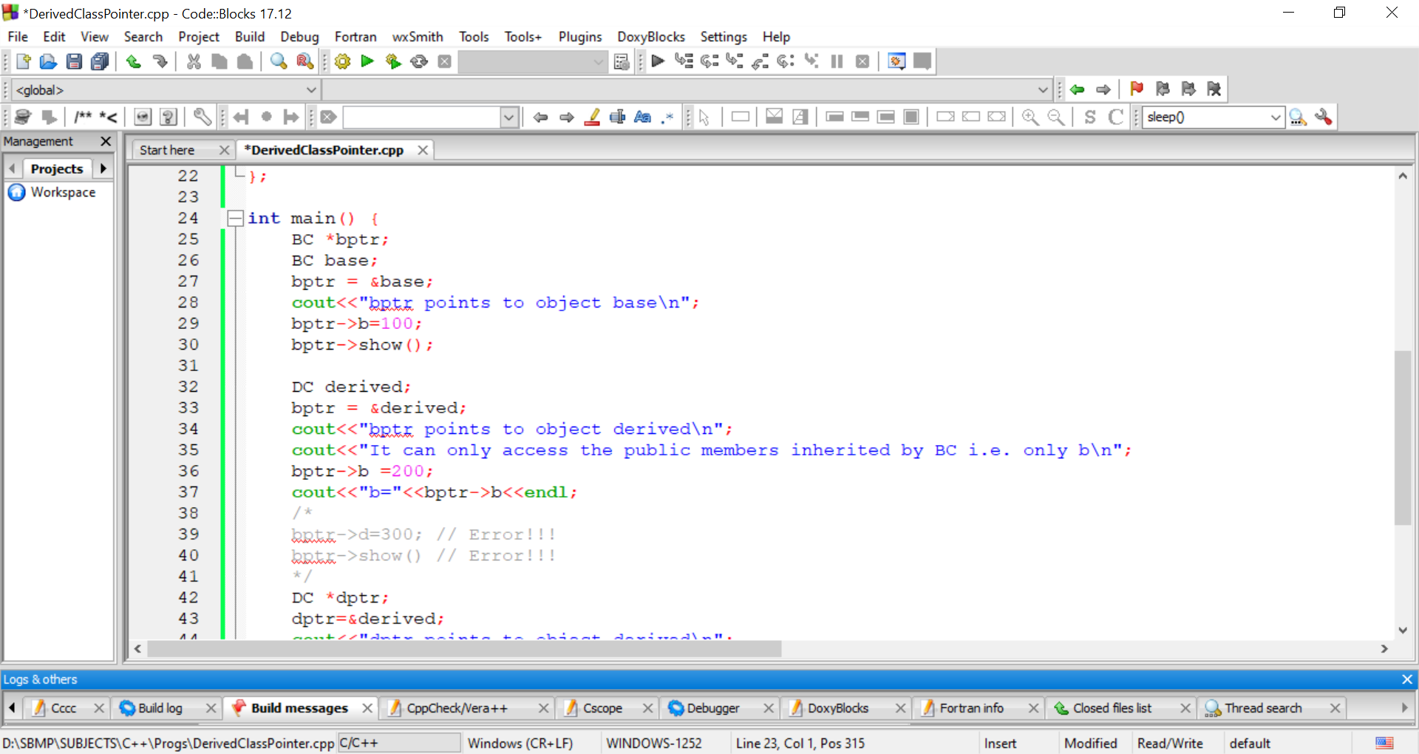
Base class pointer to derived class object
base
bptr
b=100
derived
b=200
bptr
bptr can not access d and show() of DC class

Slide 24
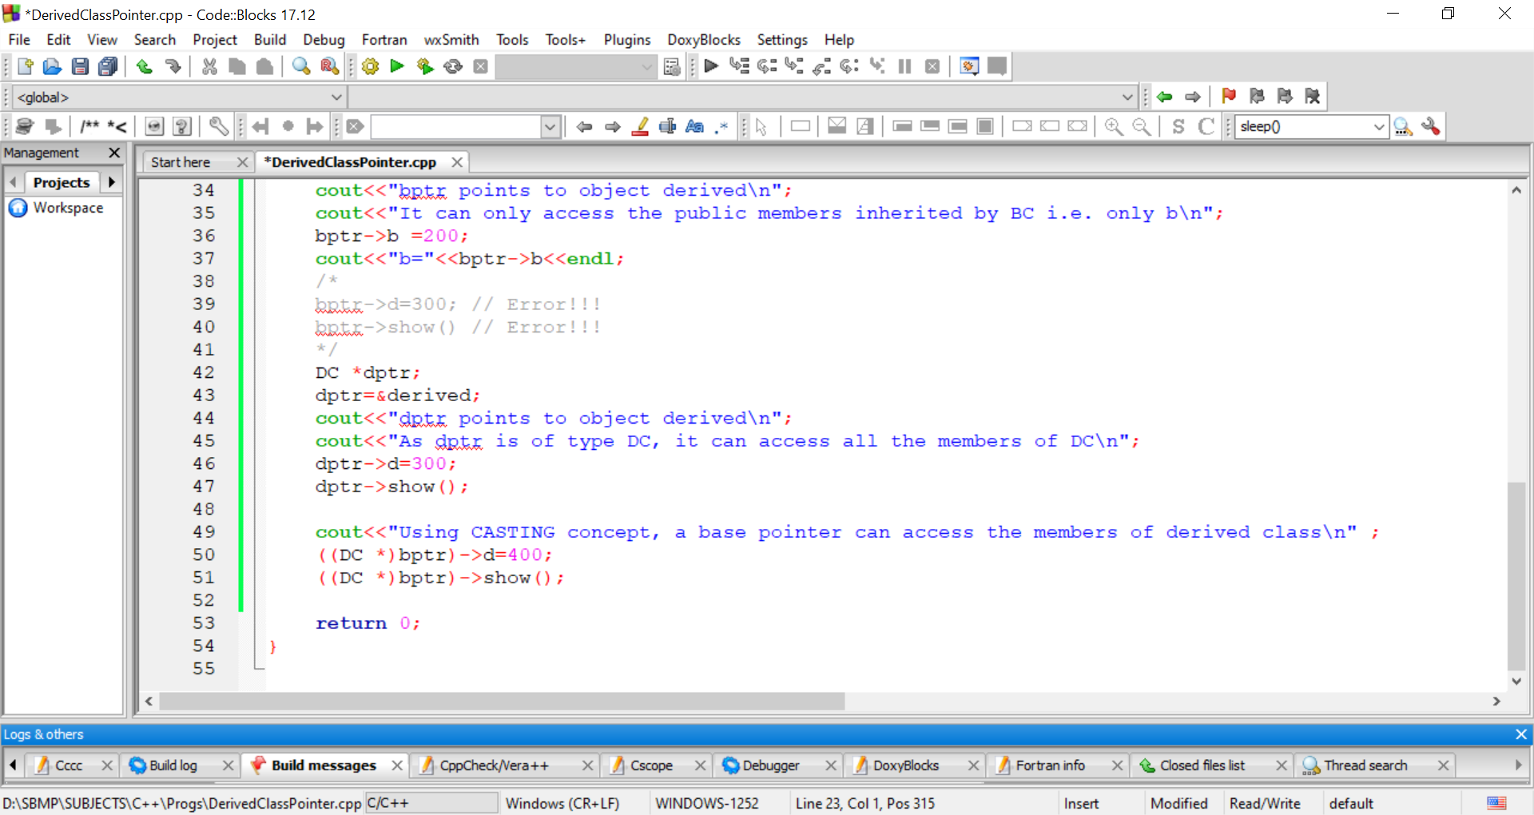
Base class pointer to derived class object
derived
dptr
b=200
d=300
b was set by bptr earlier
bptr can access all the members of DC class

Slide 25
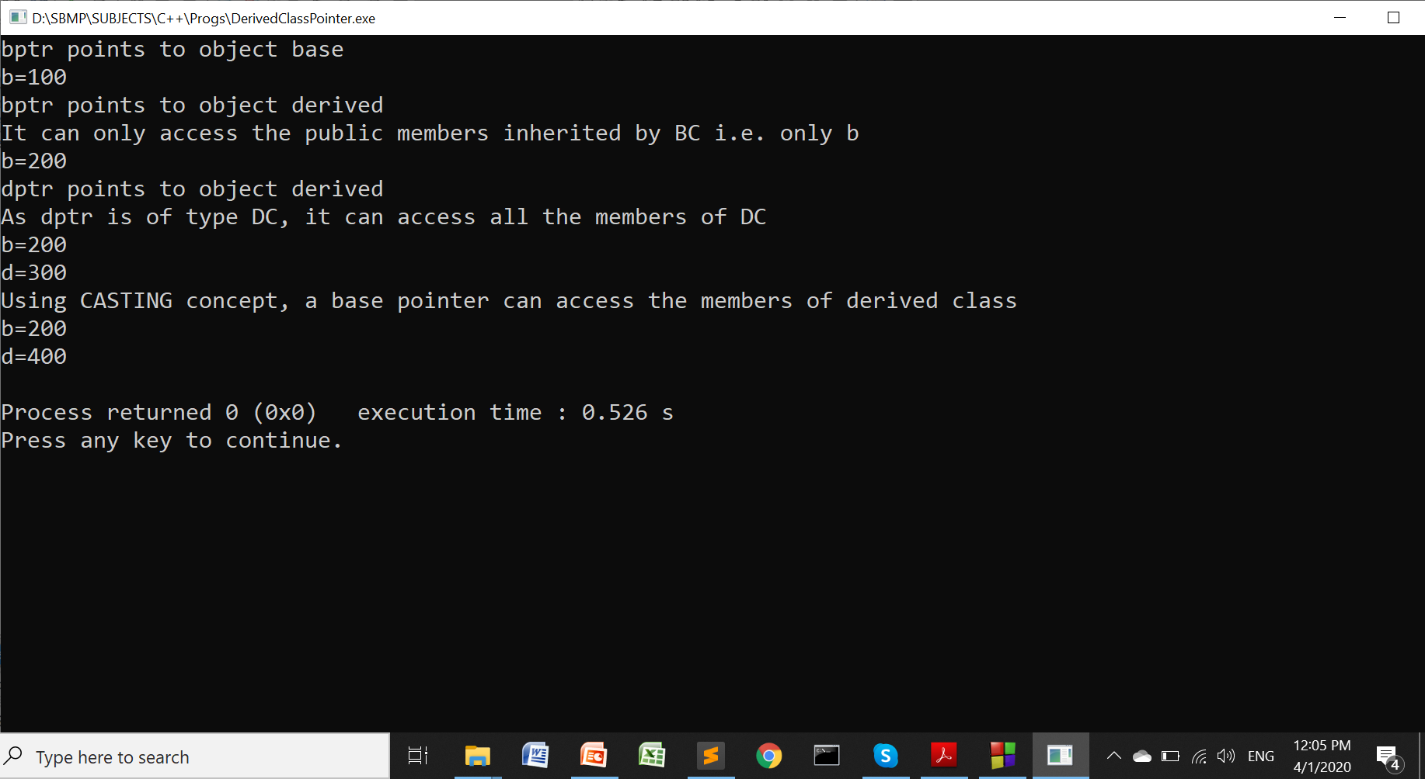
Base class pointer to derived class object

Slide 26
Runtime Poly. = Inhritance+pointer+virtual function

Slide 27
Need of Virtual Function
As we have seen that a base class pointer can point to the derived class object but it can access only those public members which are inherited by the base class.
A Runtime Polymorphism concept says “A base class pointer can point to the objects of its’ derived class and should access the members of the derived class to whom it points.”
To facilitate this , C++ provides the concept of “Virtual Function.”

Slide 28
Need of Virtual Function
When we use same function signature (prototype/syntax) in both base and derived classes, the function in the base class is declared as virtual by using virtual keyword before its declaration.
While calling a function declared as virtual, C++ determines the version of the function depending on which derived class object is being pointed by the base class pointer rather than the type of the pointer.

Slide 29
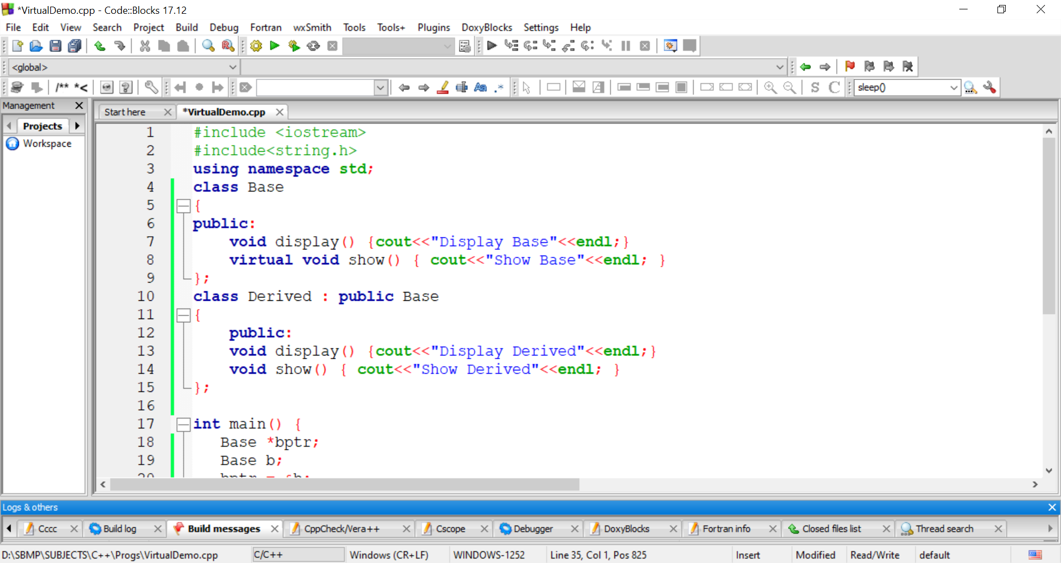
Virtual Function Example

Slide 30
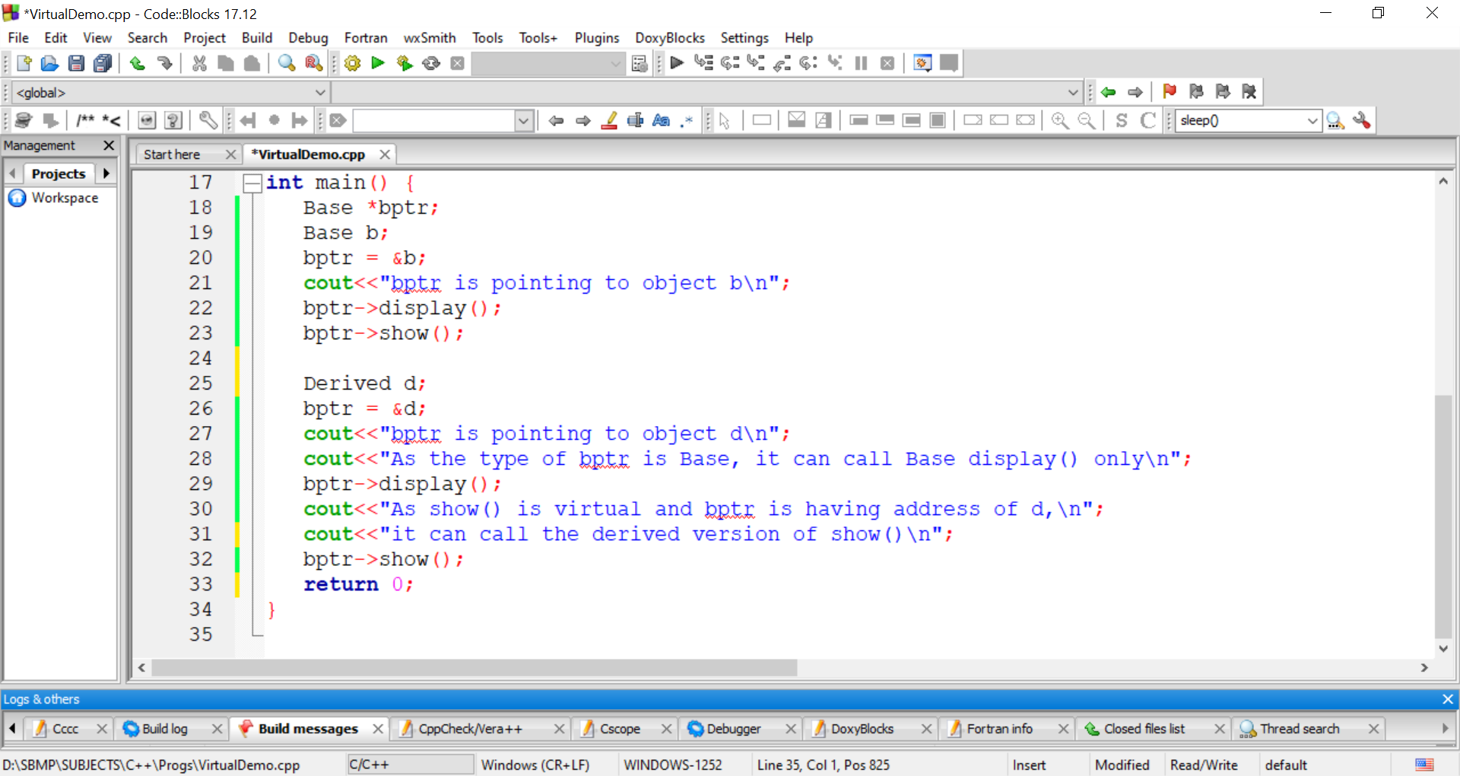
Virtual Function Example

Slide 31
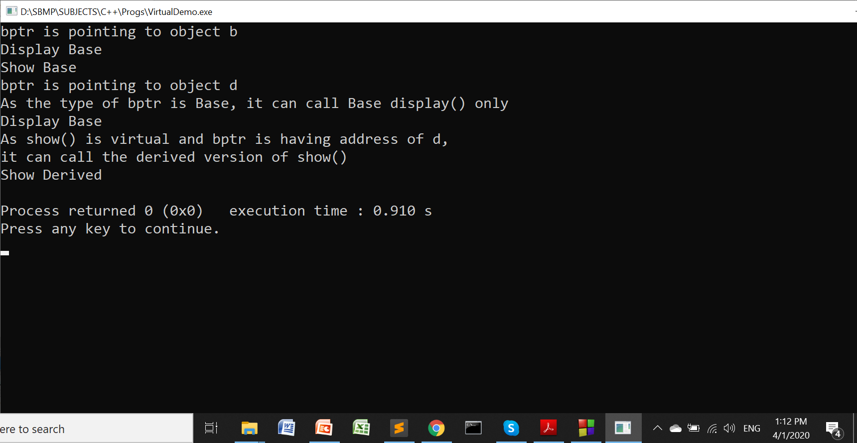
Virtual Function Example

Slide 32
Virtual Function Real World Example
Media
Book
DVD
Consider a class Media having data members title and publication price. Class Book is inheriting Media and having pages as data member. Class DVD inherits Media and having playing time (minutes) as data member.

Slide 33
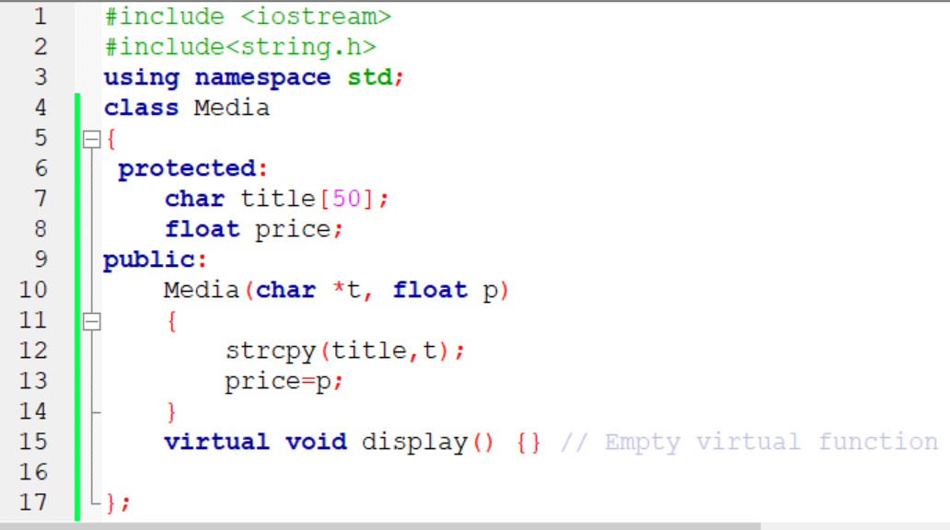
Virtual Function Real World Example

Slide 34
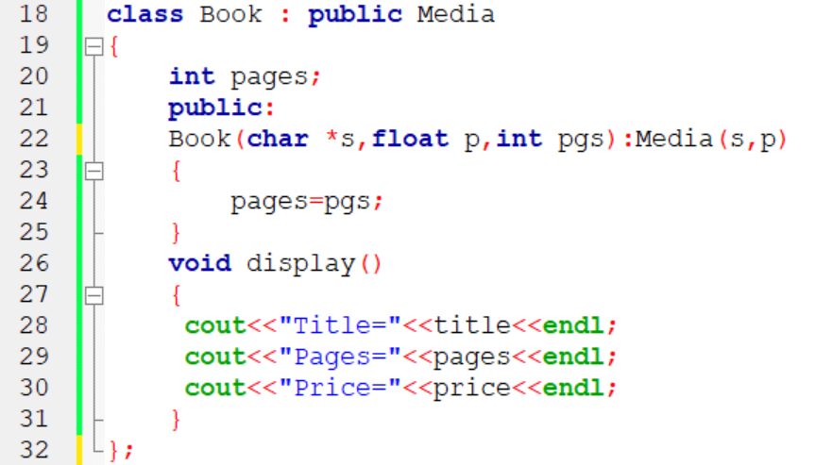
Virtual Function Real World Example

Slide 35
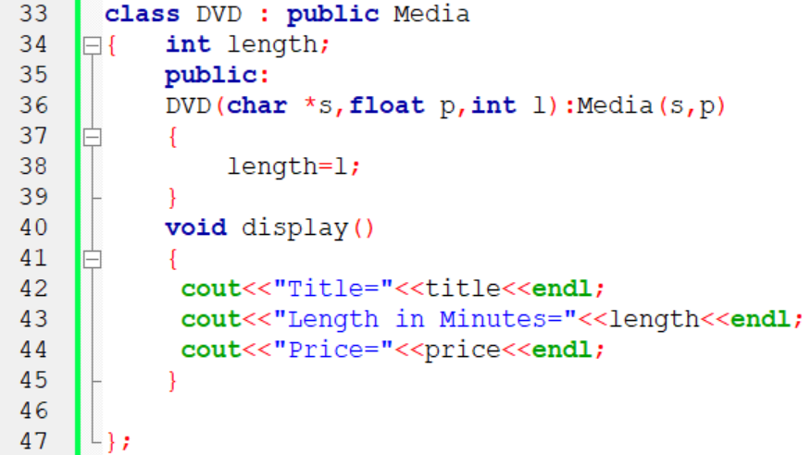
Virtual Function Real World Example

Slide 36
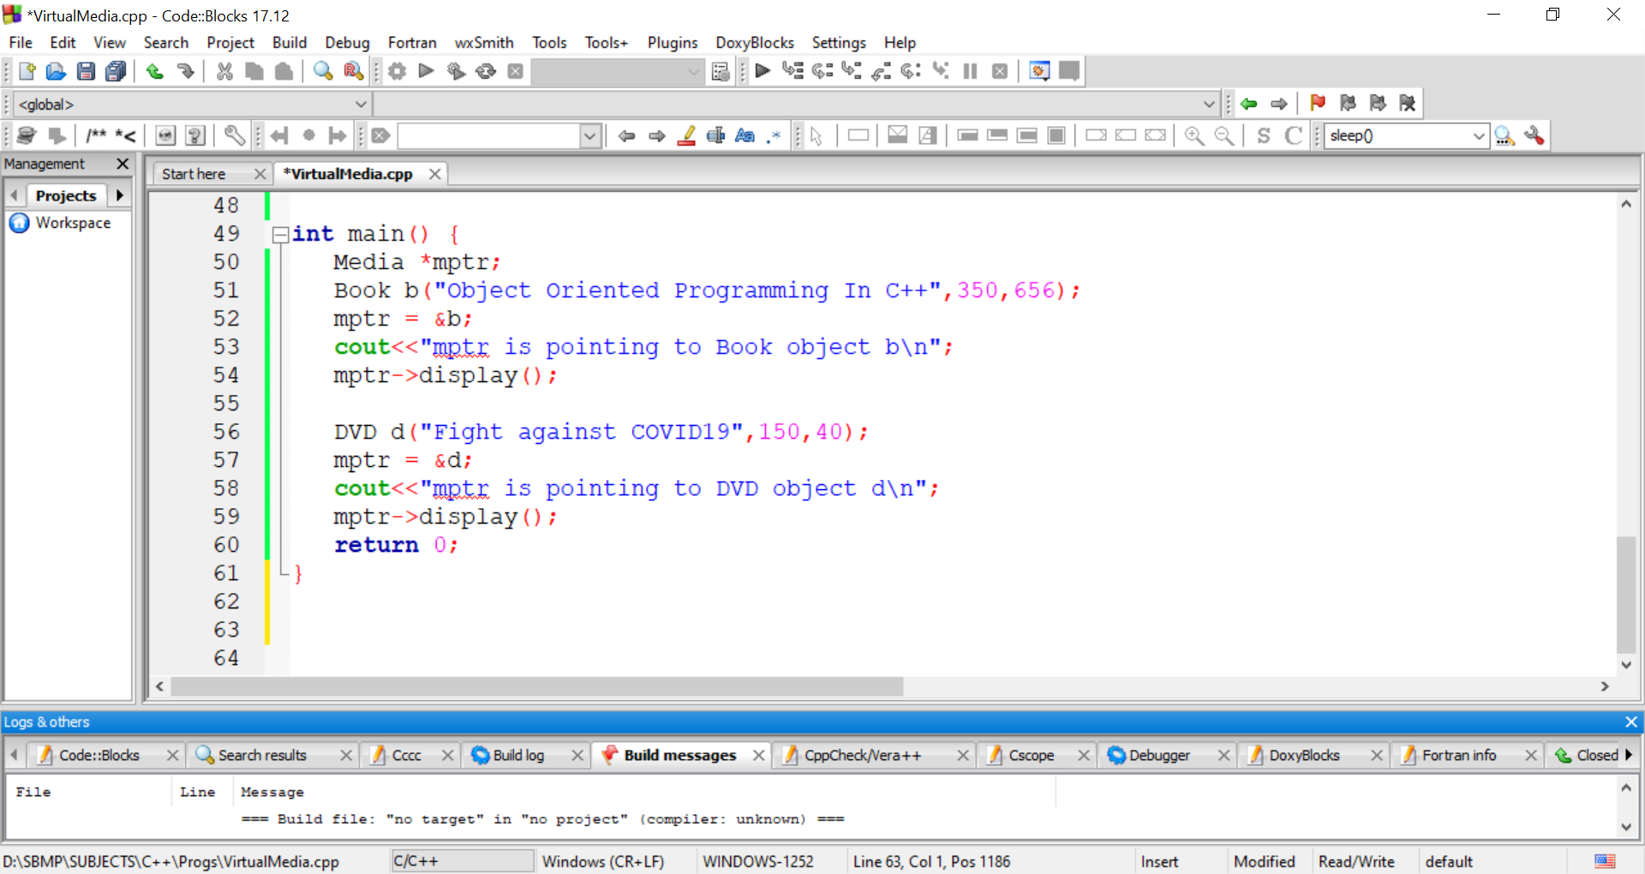
Virtual Function Real World Example

Slide 37
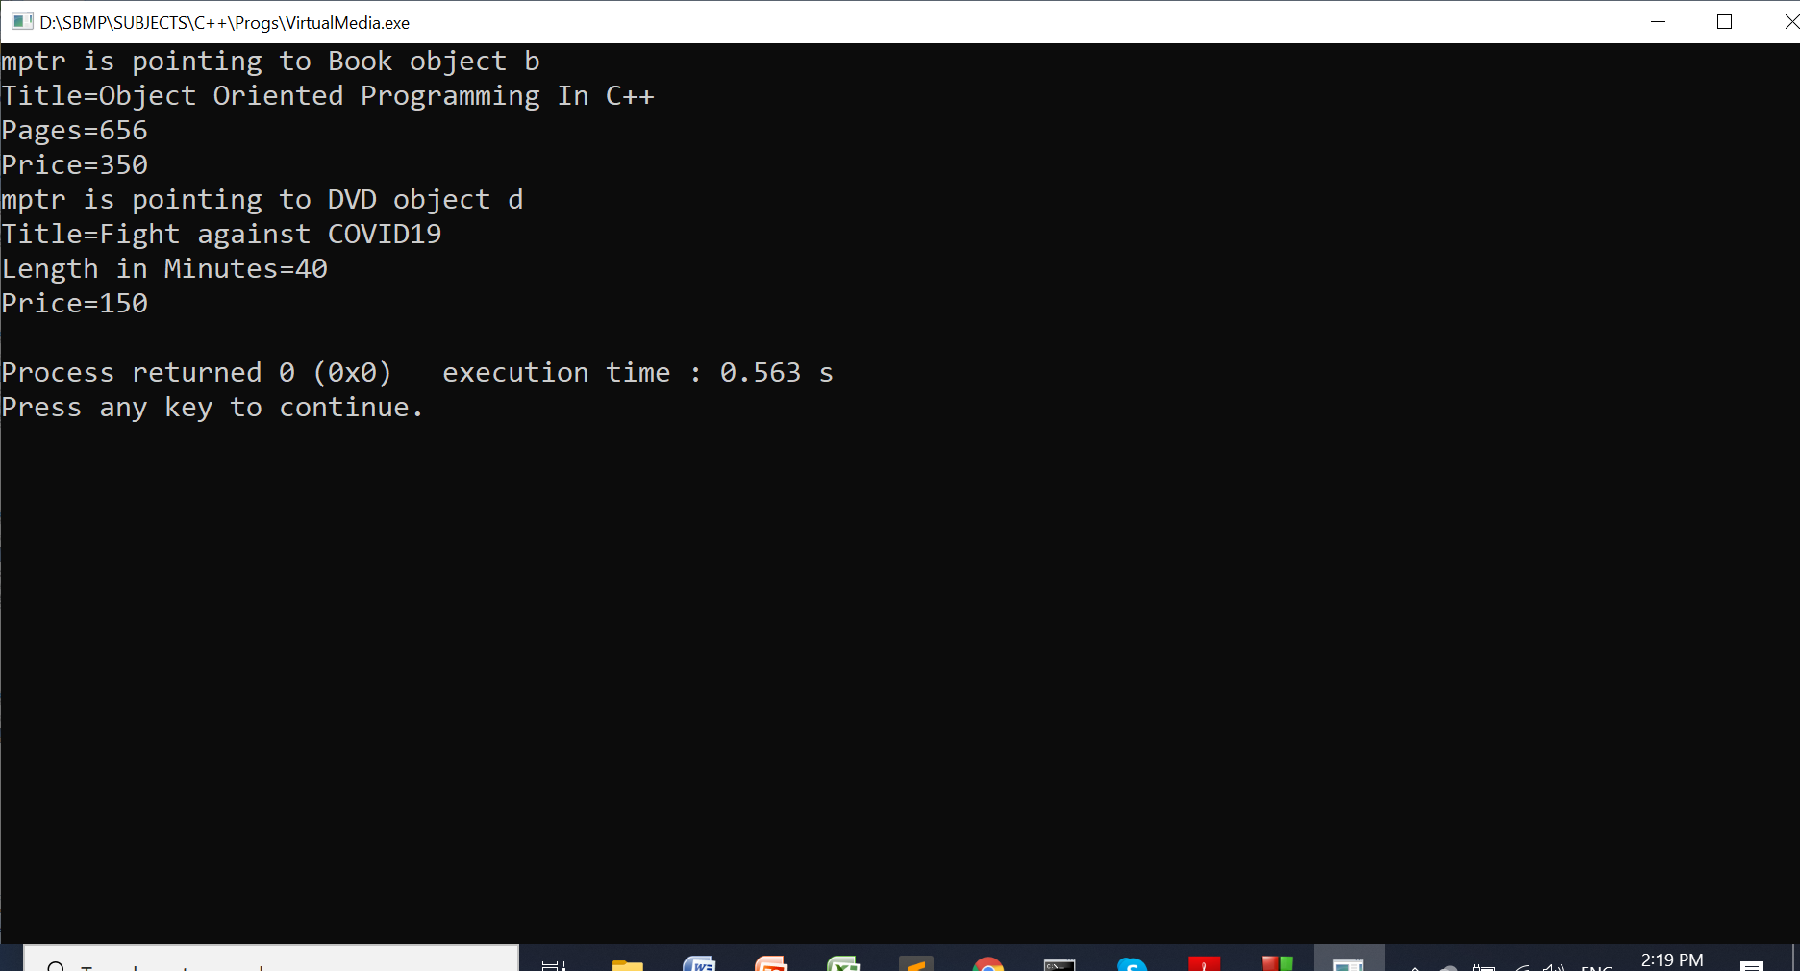
Virtual Function Real World Example

Slide 38
Rules for Virtual Function
The virtual function must me member of some class.
It can not be static.
It can be only accessed by the object pointer.
It can become a friend of another class.
The signature of base class version of the virtual function and derived class versions must be same. (return type, function name and parameter list of function must be same.)
A virtual function in the base class must be defined, even though it is not used.
We can not have virtual constructors, but we can have virtual destructors.

Slide 39
Pure Virtual Function
Usually, the virtual function inside the base class doesn’t perform any task. It works as a placeholder.
Example: In Media program, we don’t create object of type Media so there is no need to call display()
But to make it accessible to the derived classes, we have to define its empty body in the Media class.
Such “do-nothing” function can be declared as “pure virtual function”
virtual void display() = 0;
If a base class contains pure virtual function then it is mandatory for the derived class to give the body of this function.
We can not create an object of a base class having a pure virtual function.
The base class having pure virtual function is called as abstract base class.

Slide 40
Thanks!
Any questions?
You can find me at:
manish_ratilal2002@yahoo.com

Slide 41
Credits
Object Oriented Programming with C++, E Balagurusamy, TMH

